Slide 1
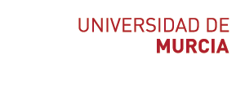
Summary of neuroscience
Speaker: Sergio López Bernal

Slide 2
Table of contents
Electrical properties of the neuron
Neurons and networks
The brain
Simulation neuroscience
Simulating a hippocampus microcircuit
2

Slide 3
Table of contents
Electrical properties of the neuron
Membrane potential
Nernst equation
GHK equation
Passive membrane properties
Voltage-gated channels
Action potentials
Myelination
Neurons and networks
The brain
Simulation neuroscience
Simulating a hippocampus microcircuit
3

Slide 4
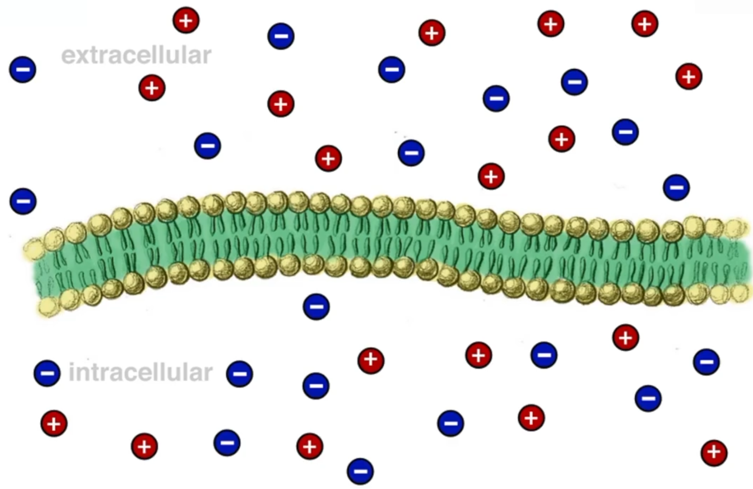
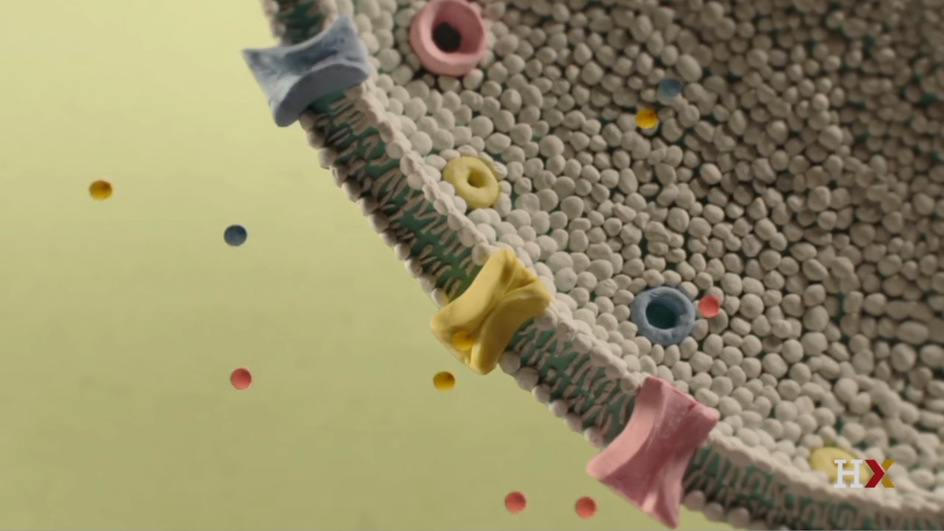
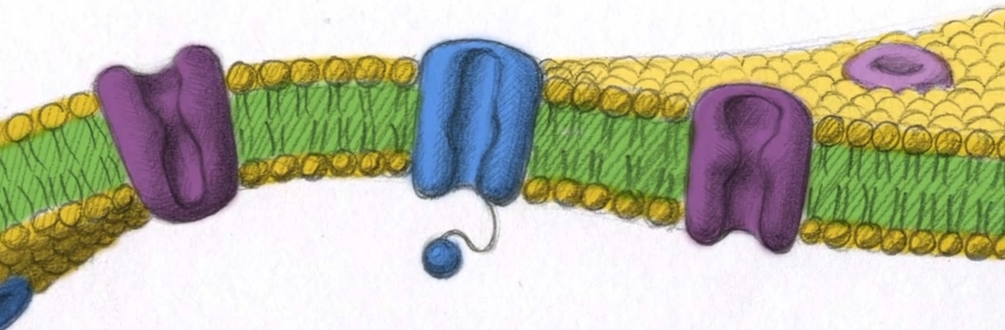
Neuronal membrane
↑ Ca⁺²
Composed of:
Lipidic bilayer membrane
Ion selective channels
K⁺, Na⁺, Cl⁻, Ca⁺²
↑ Na⁺
↑ Cl⁻
↑ K⁺
K⁺
Na⁺
4

Slide 5
Membrane potential
Each side is electroneutral: no net charge
The imbalance between extra and intra concentrations generates an electrical potential -> membrane potential
It is considered from the intracellular perspective
If the intracellular is more negative, the potential is negative
This potential changes due to the movement of ions through the membrane using passive ion channels (leaking channels)
5

Slide 6
Membrane potential
Relevant concepts:
Membrane potential: electrical potential measured across the membrane (in vs out)
Resting potential: measured membrane potential for a cell that is at rest (typically around -65 mV)
Equilibrium potential: membrane potential where electrostatic and diffusional forces exactly balance
Forces affecting membrane potential:
Diffusion: passive movement of ions from high concentrations to low concentrations across the membrane
Electrostatics: since the membrane acts as a capacitor, the charges tend to balance between intra and extracellular spaces
Electrostatic force >> diffusional force
It generates a driving force:
How hard a given ion is getting pushed across the membrane
6

Slide 7
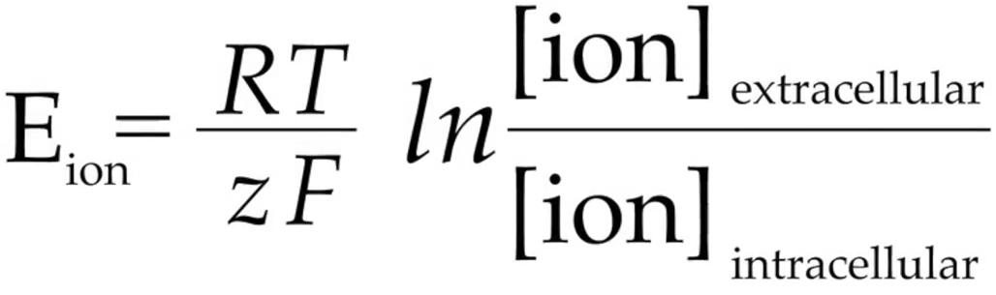
Nernst equation
Individual potential of an ion at equilibrium
When electrostatic and diffusional forces are in balance
Calculated using the Nernst equation:
Nernst potentials:
K⁺: - 80 mV Cl⁻: -70 mV
Na⁺: 90 mV Ca⁺²: 123 mV
Universal gas constant
Absolute temperature (ºK)
Extracellular
concentration (mM)
Intracellular
concentration (mM)
Nernst
potential
Ion valence (charge)
Faraday’s constant
7

Slide 8
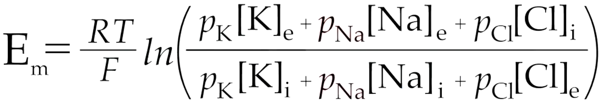
GHK equation
Used to calculate a more realistic membrane potential
Extension of the Nernst equation for multiple ions
Permeability: ease with which ions can pass through the membrane across channels.
High permeability can be produced by:
More channels
Channels allowing ions to travel more easily
Permeability coefficients
8

Slide 9
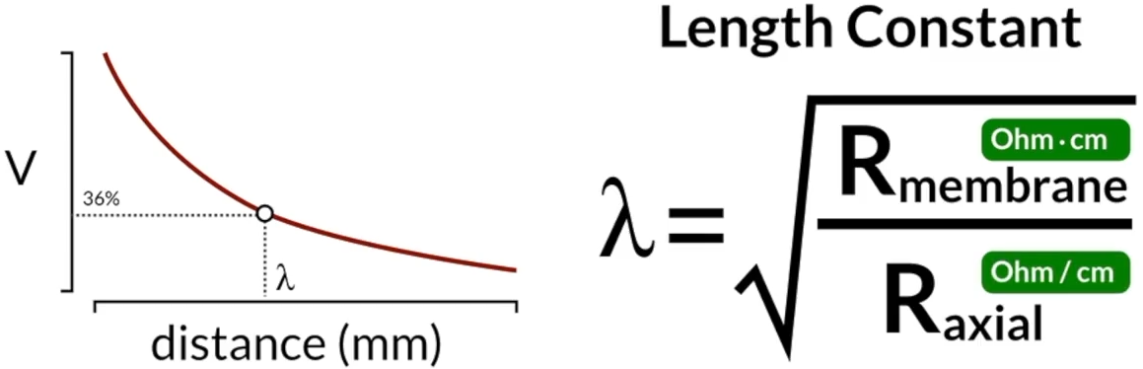
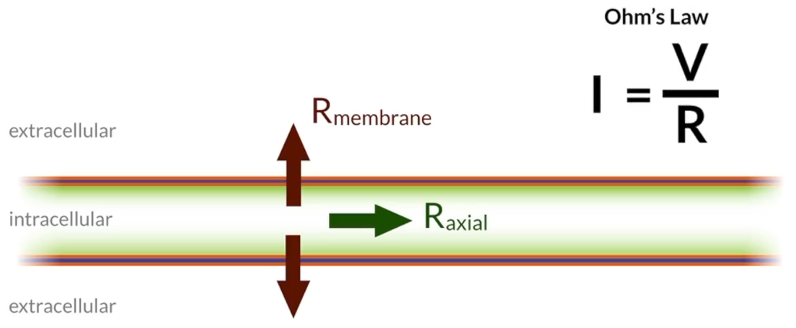
Passive membrane properties
Resistance
Opposition of flow through a particular conductor
It is inversely proportional to conductance
Each kind of ion channel has a particular resistivity
More permeability, less resistance
More channels, less resistance
Ion currents flow in two directions (two resistances):
Membrane resistance (R_{membrane})
Axial resistance (R_{axial})
Changes on one point affect adjacent membrane regions
Length constant: distance it takes for a potential change to fall off to about 36% of its initial value
9

Slide 10
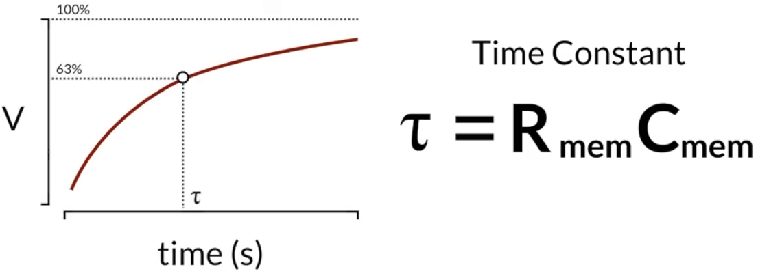
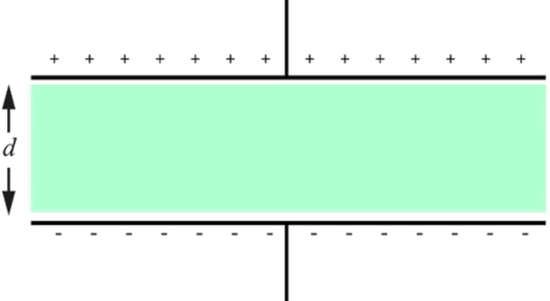
Passive membrane properties
Capacitance
Amount of electrical charge stored by a conductor
Low capacitance → membrane more responsive to change
If the dielectric is thicker, the signal propagates quicker
Membrane myelination
10

Slide 11
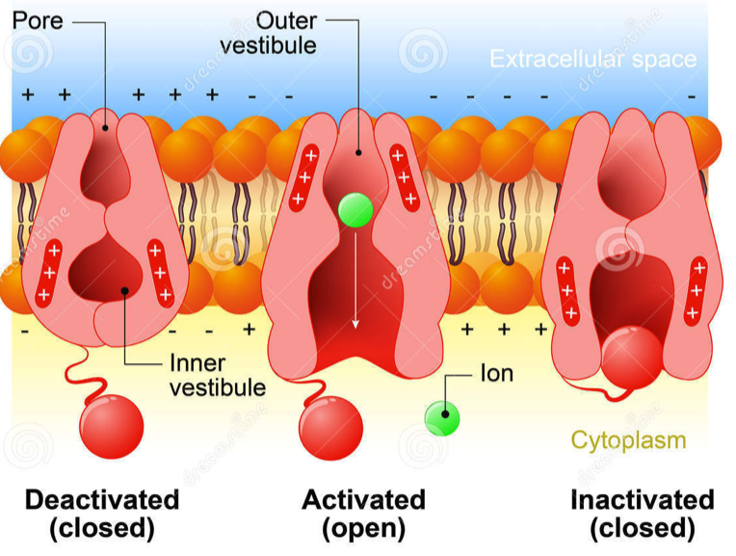
Voltage-gated channels
They change in response to their local environment
They open or close depending on the local membrane potential
Composed of complex protein structures
Na⁺ and K⁺ channels are essential to generate an action potential → sodium-potassium pump
They are not the only kind of gated channels!
Ligand-gated ion channels: open when a particular molecule binds to the channel
11

Slide 12
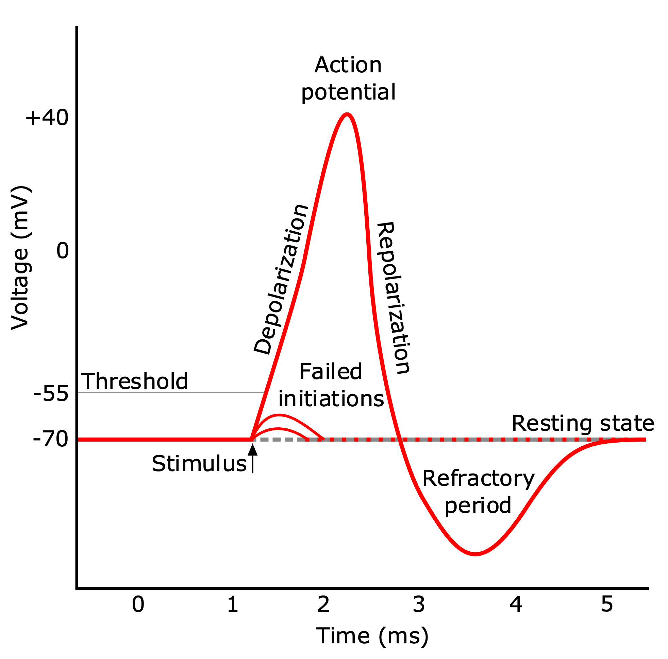
Action potentials (spikes)
Peak in membrane potential that propagates to other neurons
Interaction between Na⁺ and K⁺ voltage-gated channels
1
Resting phase
2
Stimulation
3
4
3
Rising phase
4
Falling phase
6
1
5
Hyperpolarization
2
5
6
Recovery phase
12

Slide 13
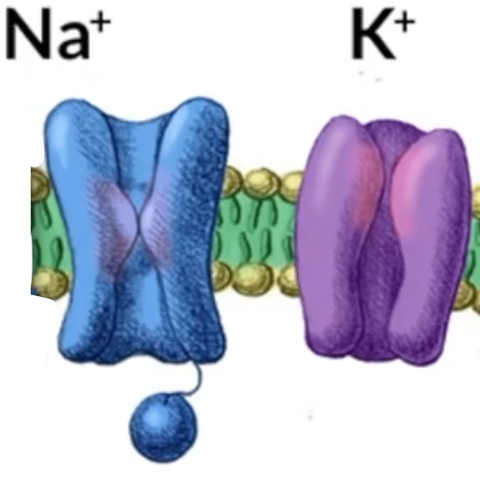
Action potentials (spikes)
Resting phase
Membrane potential = resting potential = ~ -70 mV
Na⁺ channels are closed | K⁺ channels are closed
Stimulation
Membrane potential rise until threshold (~ -55 mV)
Threshold = ~ -55 mV
1
2
13

Slide 14
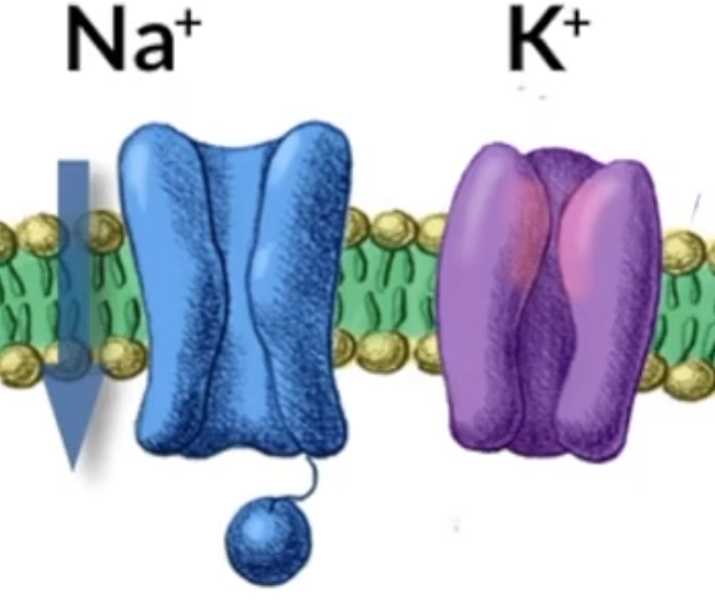
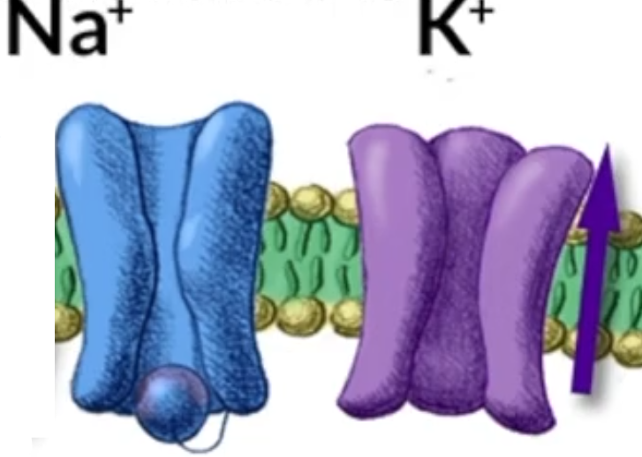
Action potentials (spikes)
Rising phase
Membrane potential: ~ -55 mV → ~30 mV
Na⁺ channels are quick to open
K⁺ channels are slow to open
Na⁺ flows to the cell
Falling phase
Membrane potential falls
Na⁺ channels are inactivated → ball closes the pore
K⁺ channels are open
K⁺ flows out of cell | Na⁺ flow stops
1
Open Na+ channels
2
3
Na+ flows to the cell
Membrane potential rises
3
4
14

Slide 15
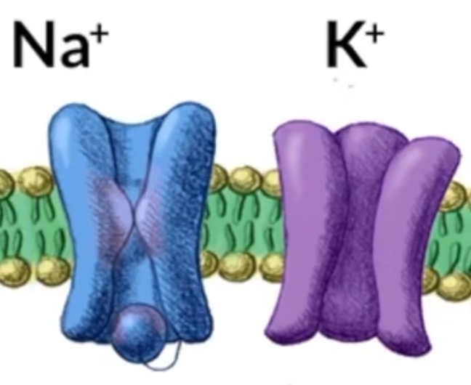
Action potentials (spikes)
Hyperpolarization (undershoot)
Membrane potential: more negative than at rest
Why? Both leakage and voltage-gated K⁺ are open
Na⁺ channels are inactivated
K⁺ channels begin to close
Na⁺ conductance is low | Na⁺ conductance falls
Falling phase
Membrane potential gradually returns to baseline
Why? Because K⁺ are progressively closing
Na⁺ channels are closed
K⁺ channels are closed
4
6
5
15

Slide 16
Refractory period considerations
During this period, we cannot stimulate another AP
Two types:
Absolute:
Driven by the inactivation of Na⁺ channels
While those channels are inactive, we cannot initiate another AP
Relative:
Occurs at the tail end of an AP
The Na⁺ channels are active again, but the K⁺ channels are still open
With a big enough stimulus, we can drive another AP to start, but it takes a bigger input since the cell is starting below the resting potential
16

Slide 17
Voltage-gated channels probability
Channels of a certain type do not open at the same time
Some states are more probable since reactions tend to drive towards the lowest energy state
The probability of the channels opening, or closing, is a function of voltage
Na⁺ channels are more stable with the voltage is high
17

Slide 18
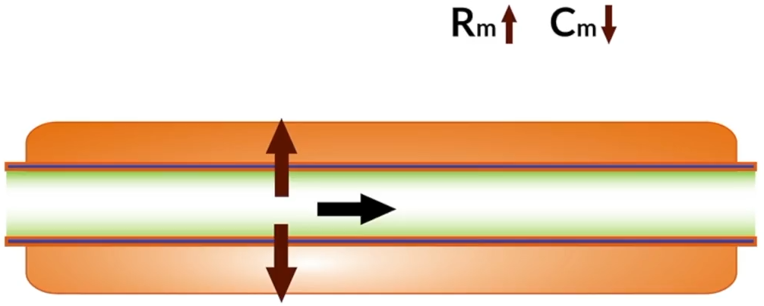
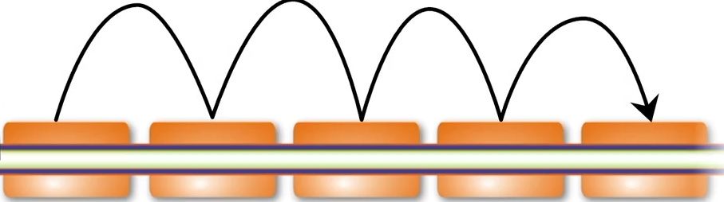
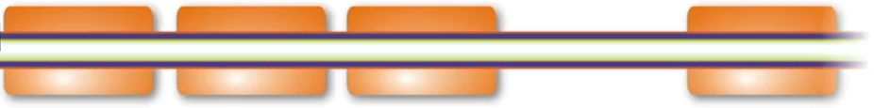
Myelination
Causes changes in the membrane potential in two ways:
Increases membrane resistance
Leaking channels blocked by myelin
Longer length constant since more current can flow down the axon
Decreases membrane capacitance
Reduces the time constant
Changes are more rapidly transmitted down the axon
Nodes of Ranvier
Relay stations where the signal is boosted again
Saltatory conduction
Demyelinating diseases
Loss of myelin, which stops the propagation of APs
Multiple sclerosis → gradual debilitating paralysis
18

Slide 19
Table of contents
Electrical properties of the neuron
Neurons and networks
The brain
Simulation neuroscience
Simulating a hippocampus microcircuit
19

Slide 20
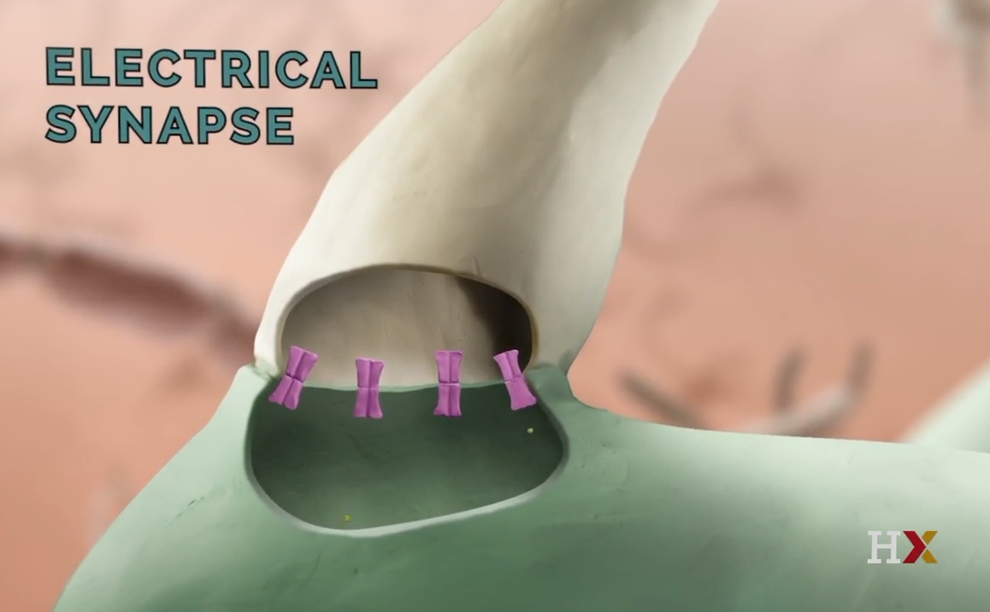
Electrical synapsis
Two neurons physically connected communication ions throw pores
A presynaptic AP causes a postsynaptic AP
Very fast, but now widely used: mainly in reflexes
Allows bidirectional signaling
Useful for synchronous signaling
20

Slide 21
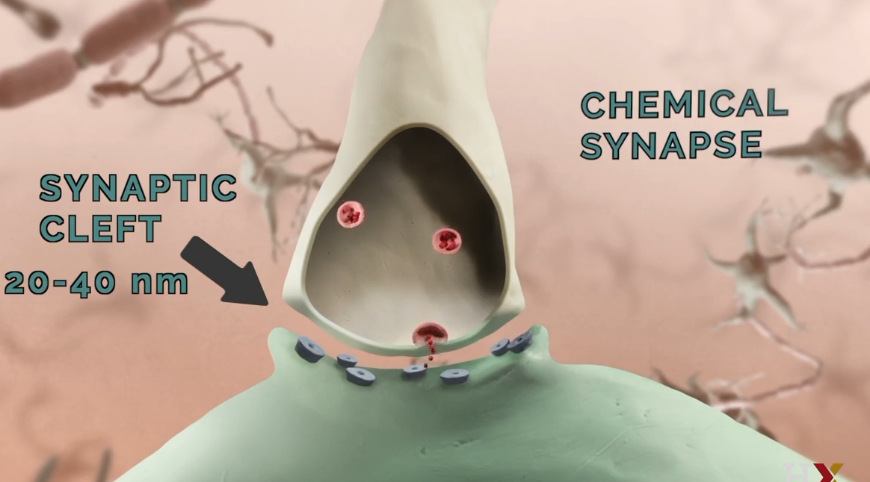
Chemical synapsis
Release of chemical substances to the synaptic cleft
Slower than electrical synapses
Dominant kind of synapsis
Advantages over electrical synapses:
Diversify of actions
Neurotransmitters: increase or decrease the likelihood of postsynaptic firing
Neuromodulators: model neuronal activity. Longer-term effects in neuronal circuits
Enforces directionality (pre → post)
An AP in the presynaptic cell does not guarantee a spike in the postsynaptic neuron
If a positive ion reaches the postsynaptic terminal, the voltage will increase. If it is negative, it will decrease.
21

Slide 22
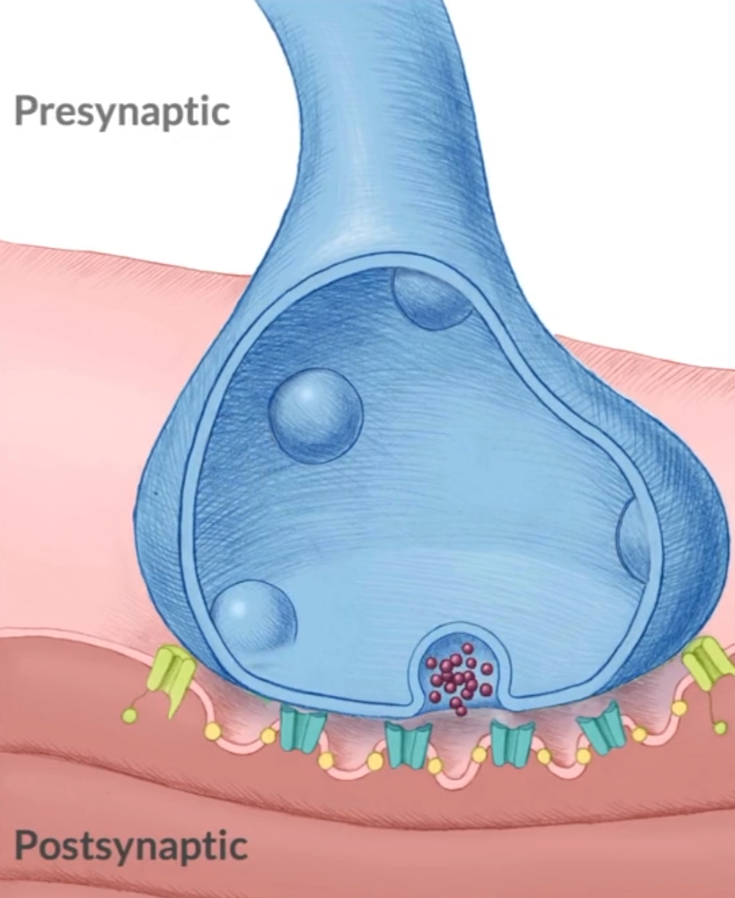
Presynaptic terminal (chemical)
Action potential arrives at the presynaptic terminal
Open voltage-gated and calcium channels
Increase of intracellular calcium concentrations
Increase the probability of releasing neurotransmitters
Vesicles contain hundreds of molecules released all at once. Vesicles fusion with the membrane
Release of neurotransmitters or neuromodulators into the synaptic cleft
Molecules diffuse across the cleft and bind the receptors of the postsynaptic neuron
Action
potential
Vesicles
Ca⁺²
channels
Ca⁺²
Neurotransmitters
Synaptic
cleft
Postsynaptic
receptors
It is all about probabilities!
Presynaptic neuron fires → increased probability to release neurotransmitters
Presynaptic neuron does not fire → small probability to release molecules
Generation of minis
22

Slide 23
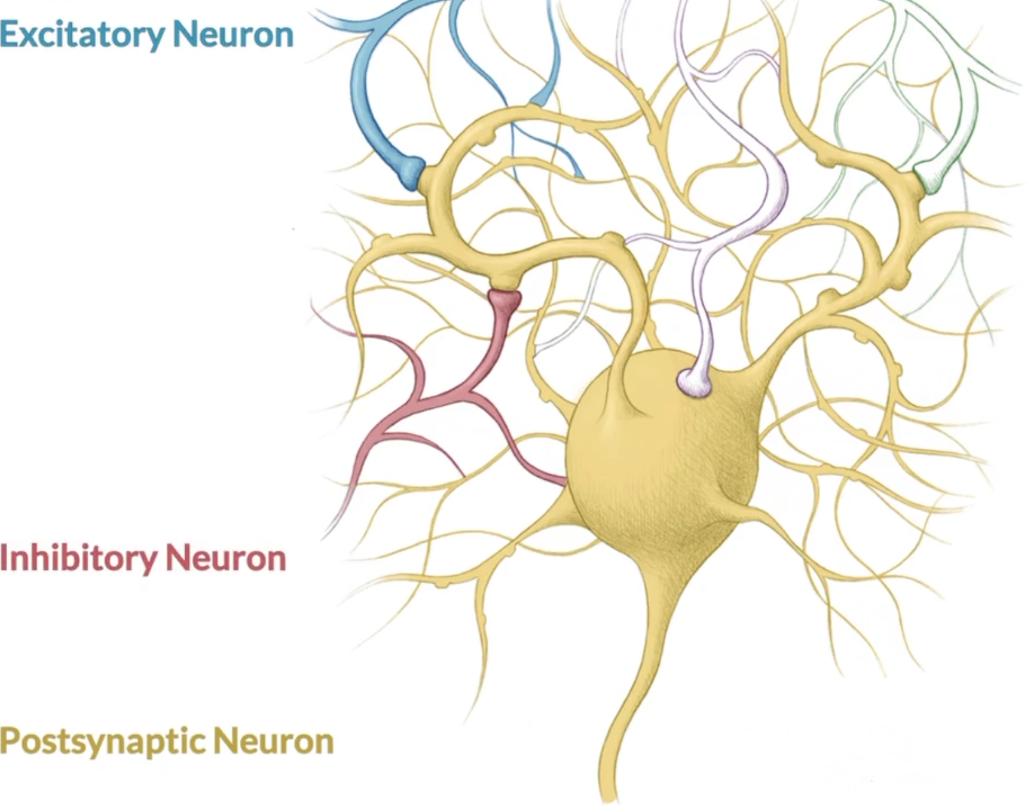
Postsynaptic potentials
Excitatory (EPSP): increase the likelihood of the postsynaptic neuron firing an action potential
Summation to the membrane potential
Inhibitory (IPSP): decrease the likelihood of the postsynaptic neuron firing an action potential
Subtraction to the membrane potential
They can be found in the dendrites and in the cell body
Effect at the axon is influenced by:
Shape
Distance
Number of synapses
Timing of the potentials
Strength of the stimuli
Frequency of the stimuli
Also known as synaptic potential
23

Slide 24
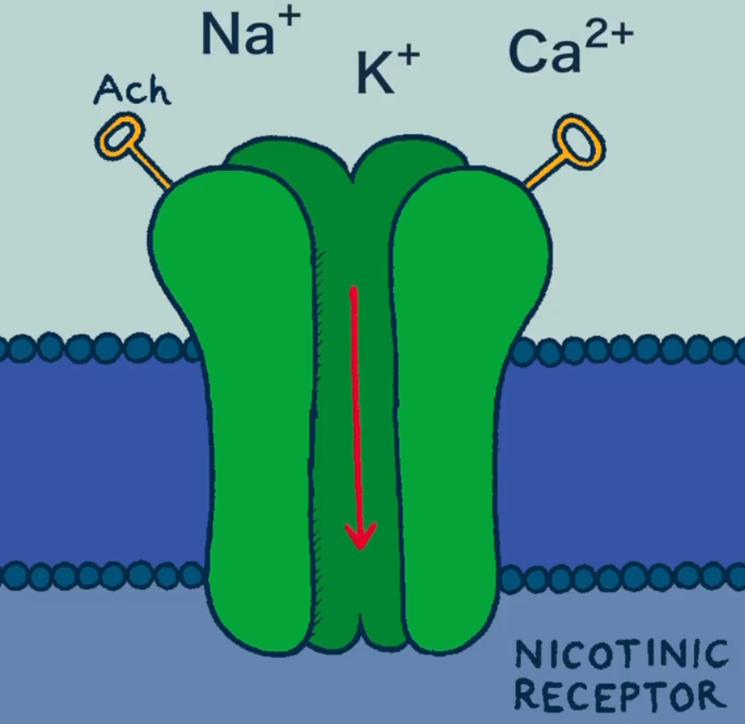
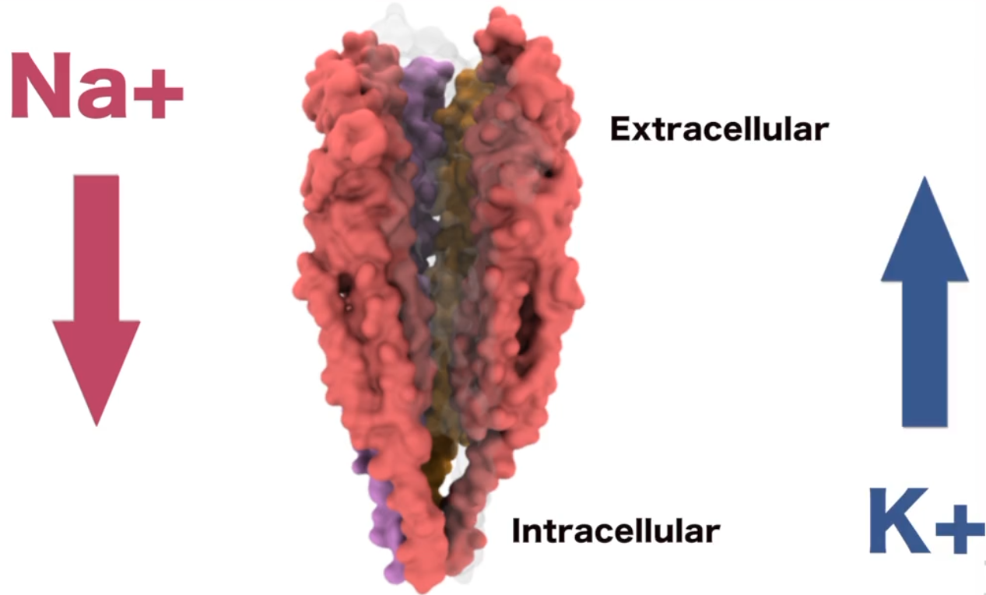
Acetylcholine neurotransmitter (EPSP)
Most common neurotransmitter in the peripheral nervous system
Muscular contractions (also heart), stomach movements, eye blinks
Also present in the central nervous system (CNS): memory, cognition
Binds to nicotinic acetylcholine receptors
Ligand-gated ion channel
Opens when a specific chemical (the ligand) binds to it
Integrated by different constellation of protein (sub-units)
Na⁺ flows into the cell, K ⁺ flows outside the cell
After a certain duration open, channels close to avoid a continuous excitation (desensitization process)
Use of succinylcholine as drug for muscle relaxant during surgery → binds to these receptors
24

Slide 25
Glutamate neurotransmitter (EPSP)
Vast majority of all fast EPSP in the CNS
Different functions based on a wide variety of postsynaptic glutamate receptors
Ionotropic glutamate receptors
AMPA receptors
Ligand-gated channels
The most common receptor in the nervous system
Permeable to all cations (positive ions)
NMDA receptors
Role in many cognitive functions, most extensively studied for their role in synaptic plasticity, learning and memory
Can be activated both by ligand binding and changes in membrane potential
Metabotropic glutamate receptors
Change the metabolic and biochemical pathways acting indirectly through G protein coupled receptors (GPCRs)
GPCRs sense molecules outside of the cell and activate specific signal transduction pathways and thus cellular responses inside the cell
25

Slide 26
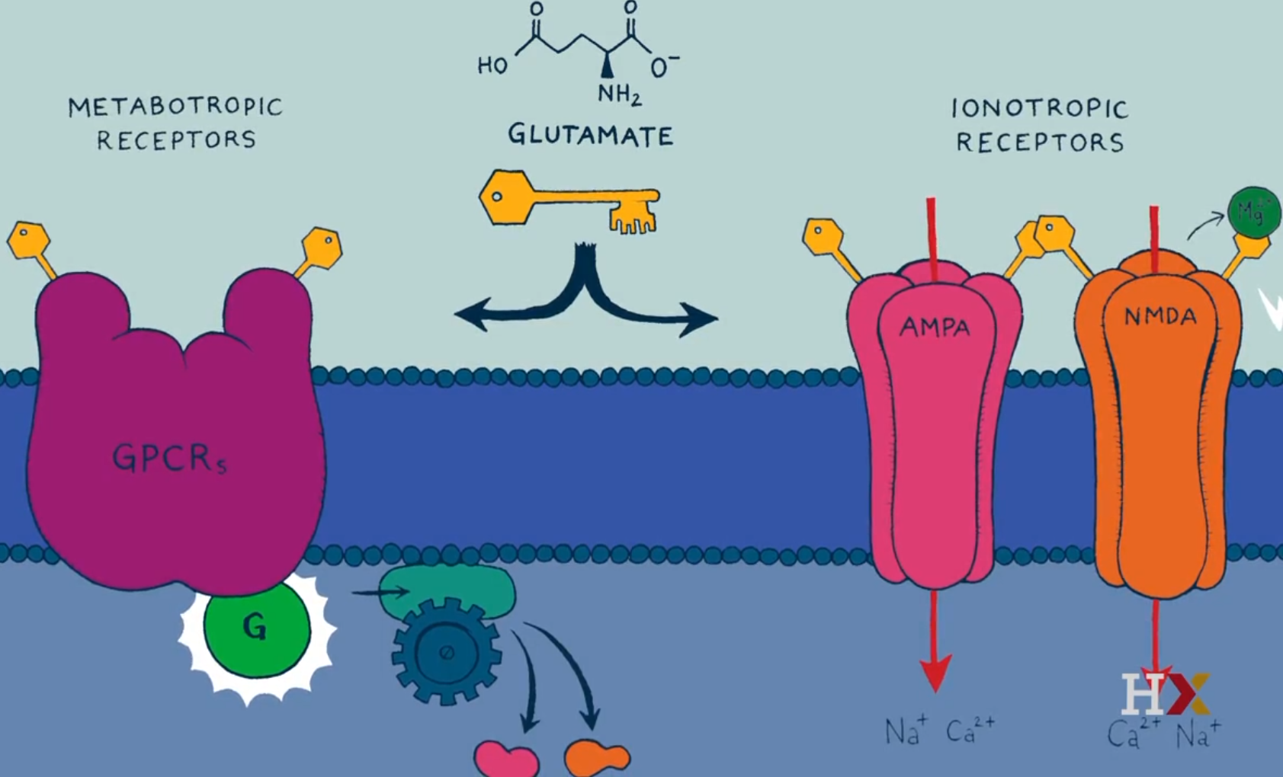
Glutamate neurotransmitter (EPSP)
26

Slide 27
Excitation disease states
Disbalance between excitation and inhibition
Myasthenia gravis
Autoimmune disorder where antibodies in the blood block or even destruct acetylcholine receptors in the neuromuscular junction
Causes serious muscle weakness and fatigue
Congenital myasthenic syndrome
inherited neuromuscular disorder caused by defects of the proteins that make up the neuromuscular junction
Typically generates abnormalities in the nicotinic acetylcholine receptors
Causes serious muscle weakness and fatigue
27

Slide 28
Neural inhibition
Agonist GABA substances
Barbiturates
Depressant of the CNS
Benzodiazepines
Significantly less dangerous to overdose than barbiturates
Sedative, anti-convulsant, muscle relaxant: anxiety, insomnia, epileptic seizures
Alcohol
Antagonist substances
Strychnine (Glycine)
Found in rat poison
Muscular convulsions, death through asphyxiation
Picrotoxin (GABA)
Stimulant and convulsant effects, muscle rigidity and seizures
Used to counter barbiturate poisoning
Use of ligand-gated ion channels
Similar in structure to the excitatory nicotinic acetylcholine receptor
Anion-selective ion channels
Increase in chloride conductance
Forces the membrane potential to stay close to the equilibrium potential of Cl⁻, which is close to the resting potential
Two types of receptors:
GABA receptors: primary inhibitory receptors in the brain
Glycine receptors: primary inhibitory receptors in the spinal cord
28

Slide 29
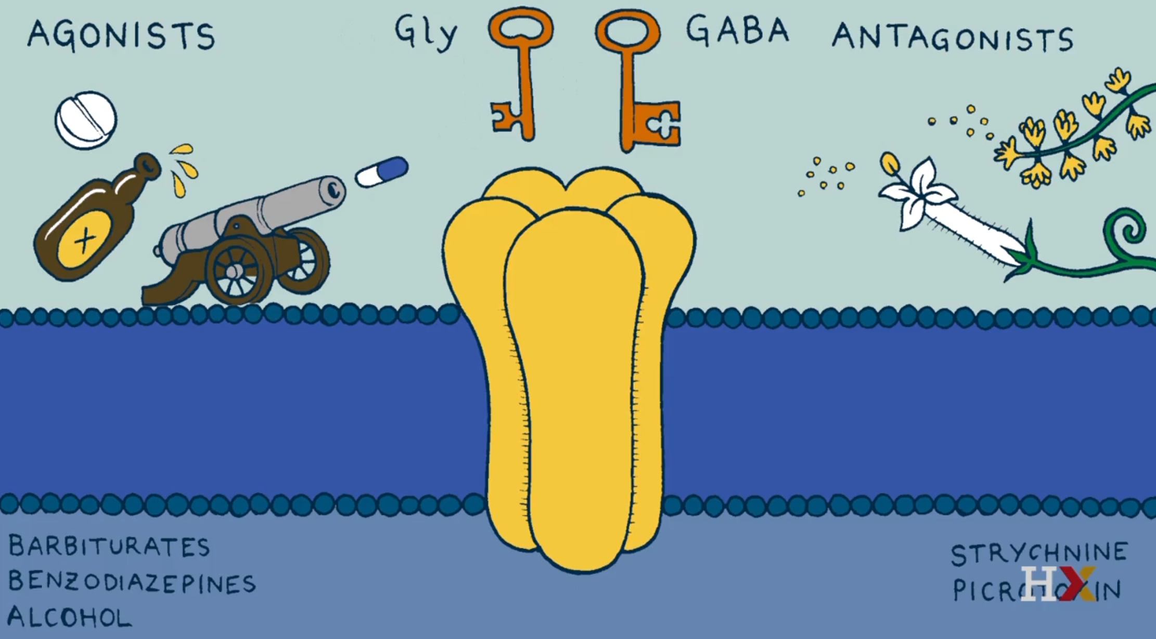
Neural inhibition
Picrotoxin
29

Slide 30
Inhibitory disease states
Hyperekplexia
Caused by alterations in genes encoding the glycine neurotransmission pathway
Cause
Exaggerated startle response to external stimuli sensed by touch or acoustically
Symptoms
Force closure of the eyes
Extension of the extremities followed by a period of generalized stiffness
At times, uncontrolled falling
Treatment
Clonazepam → increase inhibitory effects of GABA
30

Slide 31
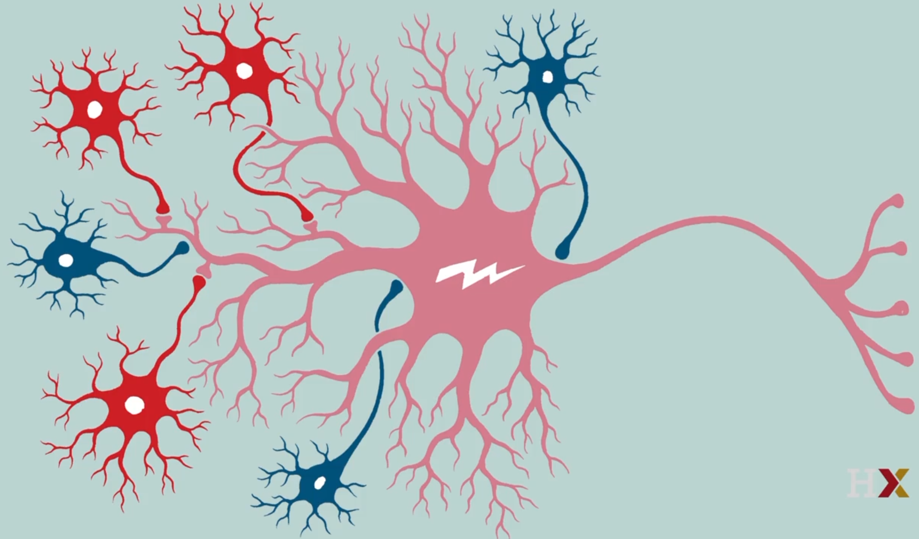
Small neuronal circuits
A single neuron is innervated by up to thousands of incoming synapses
Where are synapses placed in postsynaptic neurons?
Excitatory
Dendritic spines
Inhibitory
Dendritic shafts
Soma (cell body)
Axon initial segment
Factors regulating synaptic efficacy (ability to initiate an AP):
Distance
Non-linear summation
Inhibitory input blocking excitatory input
Temporal summation
Inhibitory input blocking temporal summation
Dendritic spines
Axon initial
segment
Dendritic shafts
Soma
31

Slide 32
Distance
Signal decreases when the distance increases
The shape of the neuron also affects distance:
Dendritic branches farther away from the soma are smaller and thinner in diameter.
Decreases the length constant (higher axial resistance)
Greater signal loss
Synapses closer to the soma are more probable to fire an action potential
32

Slide 33
Non-linear summation
The amplitude of the combined EPSPs in an axon hillock is smaller than the sum of the amplitudes of the individual potentials
Why?
Driving force
Considering a postsynaptic site with ionotropic receptors permeable to a certain ion.
When exciting the synapse, the postsynaptic membrane gest closer to the Nernst potential of the ion (E_{i}).
The closer the membrane potential gets to E_{i} :
The lower the net driving force
The lower the net depolarization added as you open more channels in the same patch of membrane
Dendritic action potentials
Dendrites also have voltage-gated channels and action potentials
Not always taught in standard textbooks but are important to the function of the brain
Action potentials backpropagation
APs in the soma don't stay in the soma
Cytoplasm that conducts dendritic postsynaptic potentials to the soma also passively conducts currents from the AP back into the dendritic arbor.
These back propagating APs influence the effects of incoming EPSPs in complex ways.
33

Slide 34
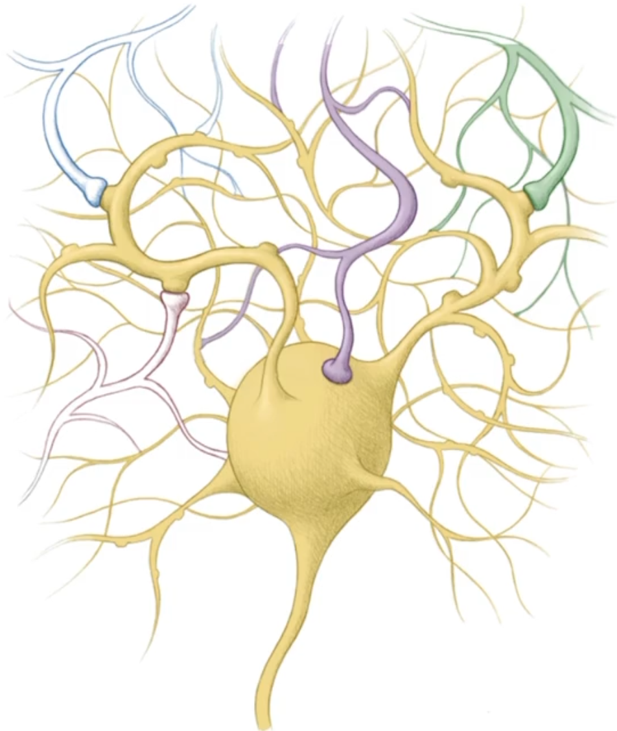
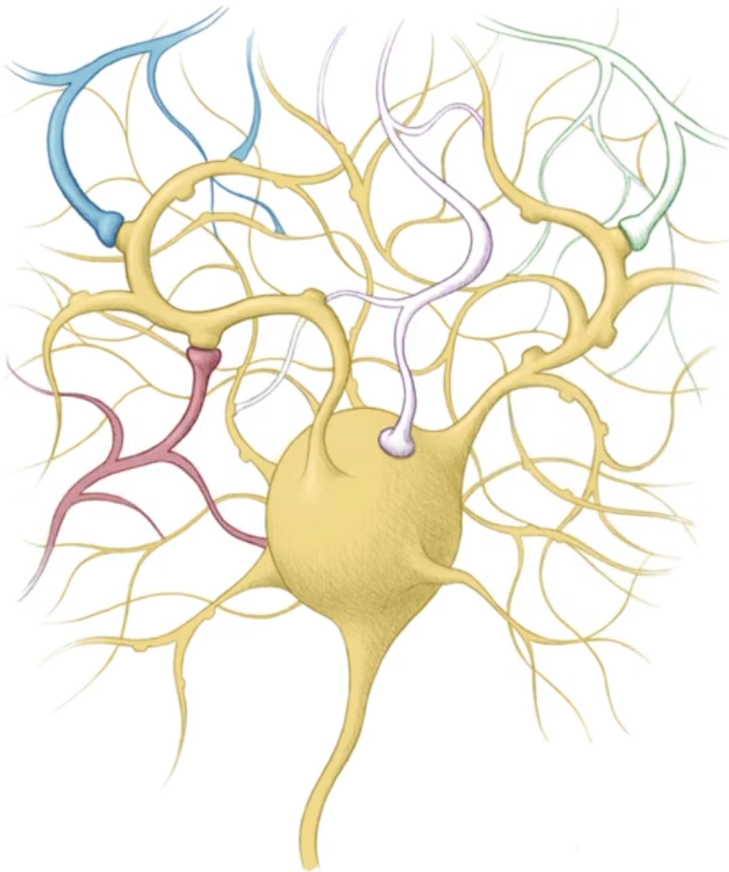
Synaptic inhibition
Excitatory
For maximum effect, inhibitory synapses must be closer to the soma than excitatory synapses
If not, the EPSP is able to reach the soma and depolarize the neuron
An inhibitory synapse on the cell body can counteract any excitatory signals from the dendritic arbor
An IPSP closer to the soma can counteract any EPSP that is farther from the soma
Inhibition of all EPSPs
reaching the neuron
Inhibitory
Excitatory
Inhibition of all EPSPs
over the inhibitory synapsis
Inhibitory
34

Slide 35
Synaptic temporal summation
Course fundamentals 2, lesson 3, 6 docx
I LEFT THIS SECTION INCOMPLETE JUST TO MOVE TO COMPUTATIONAL NEUROSCIENCE COURSES. COMPLETE THIS COURSE AND THE ONE ADDRESSING THE BRAIN AS WHOLE
35

Slide 36
Table of contents
Electrical properties of the neuron
Neurons and networks
The brain
Simulation neuroscience
Simulating a hippocampus microcircuit
36

Slide 37
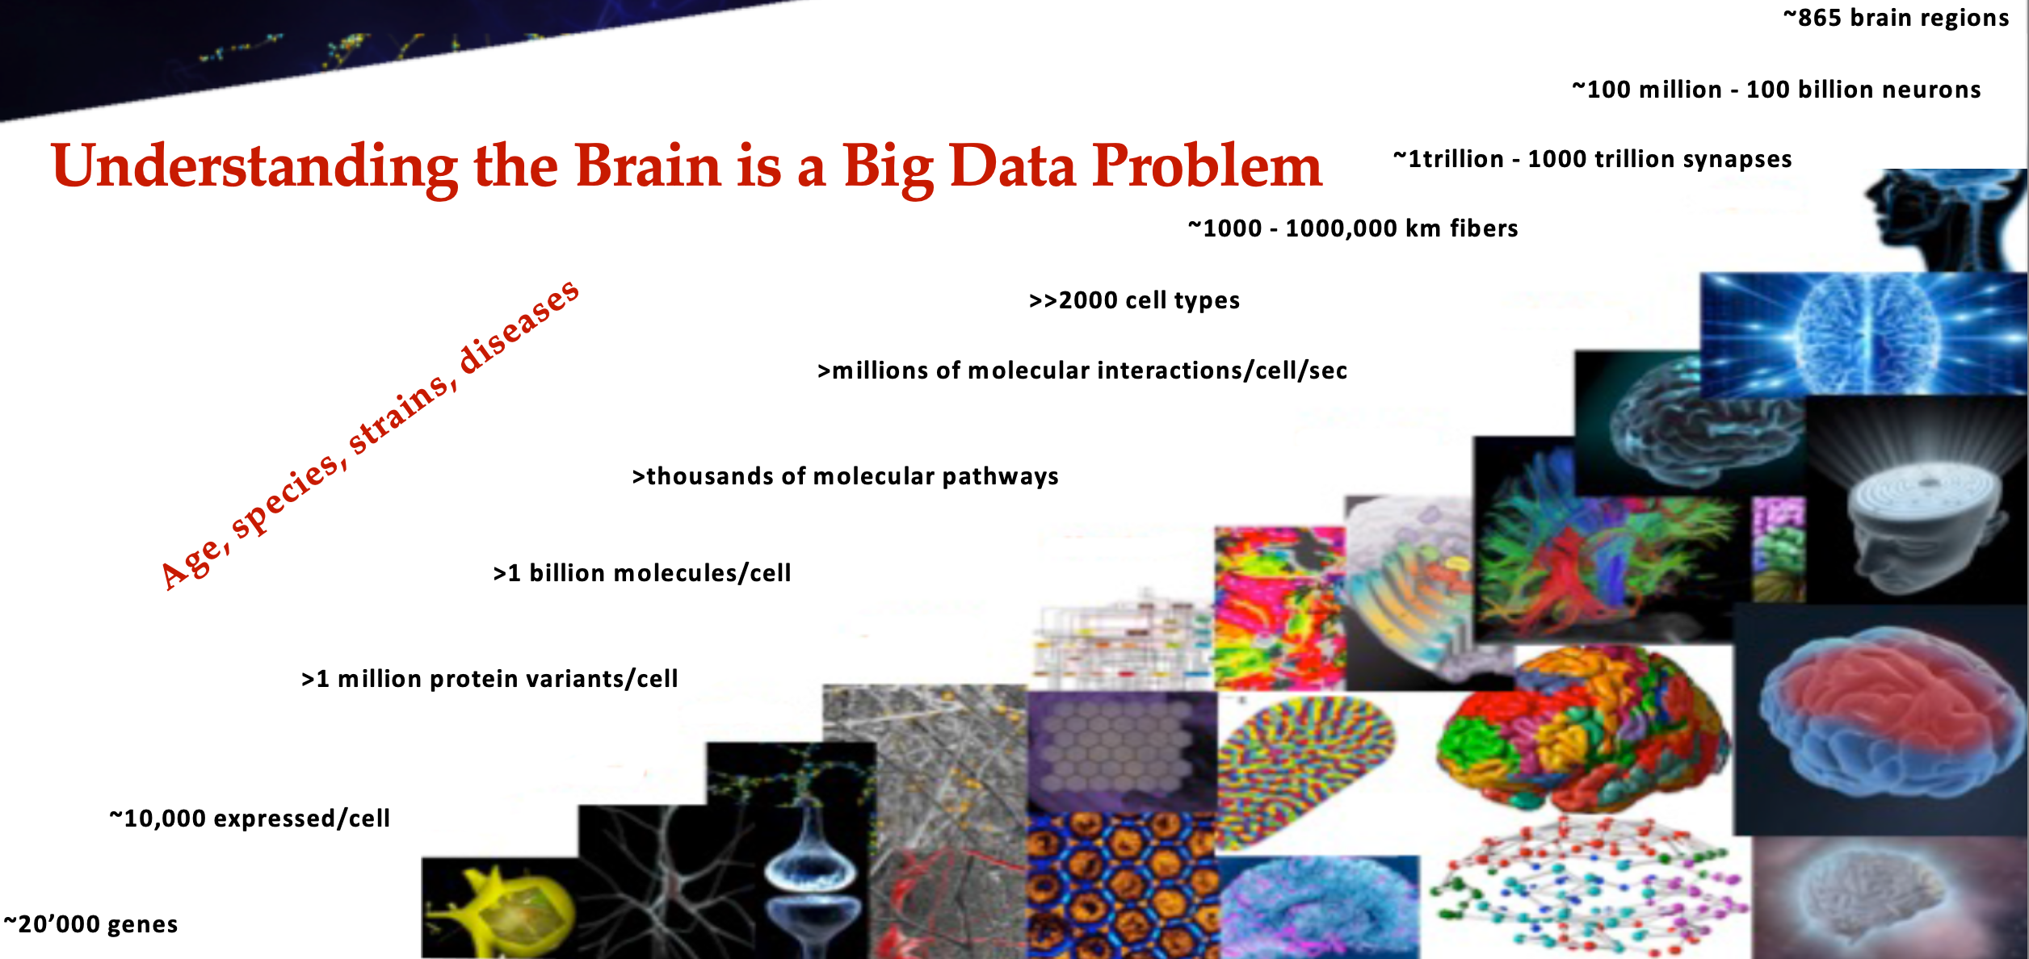
Neural data complexity
37

Slide 38
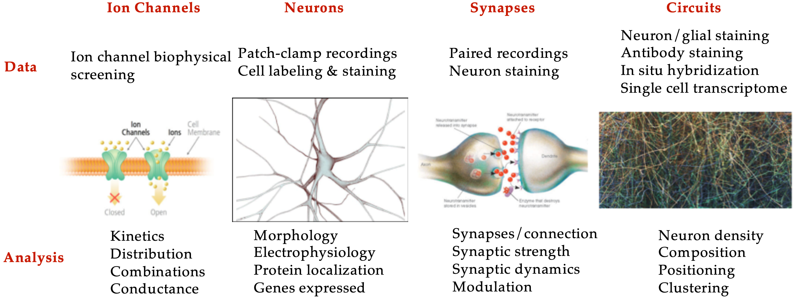
Levels of reconstruction
38

Slide 39
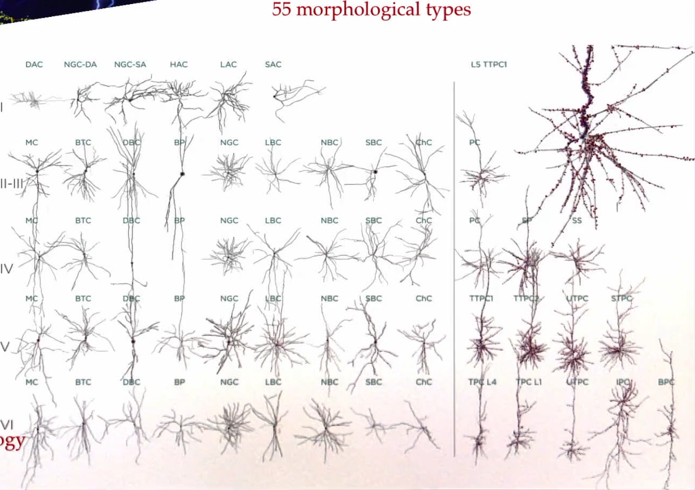
Morphological types
55 m-types
Inhibitory
Excitatory
39

Slide 40
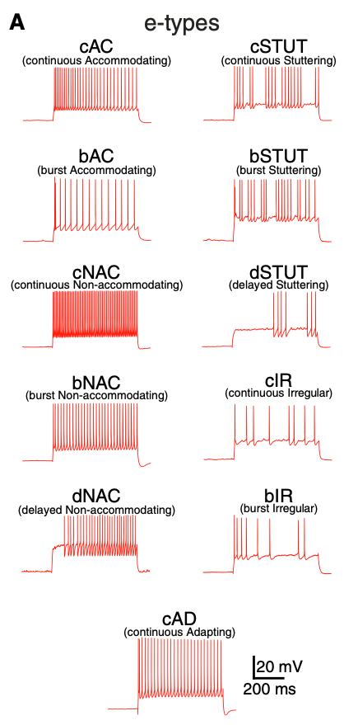
Physiological types
11 electrical types (e-types)
40

Slide 41
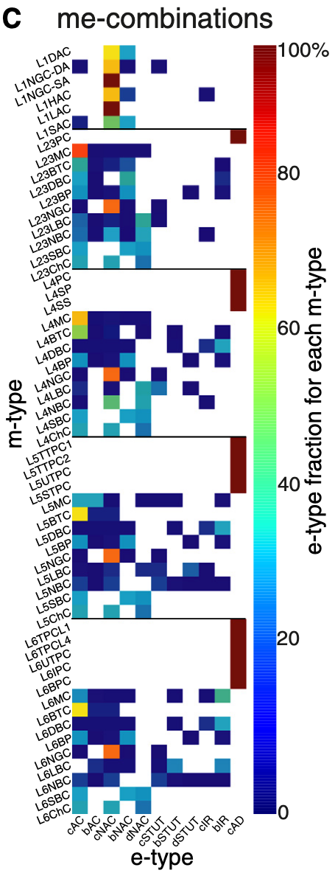
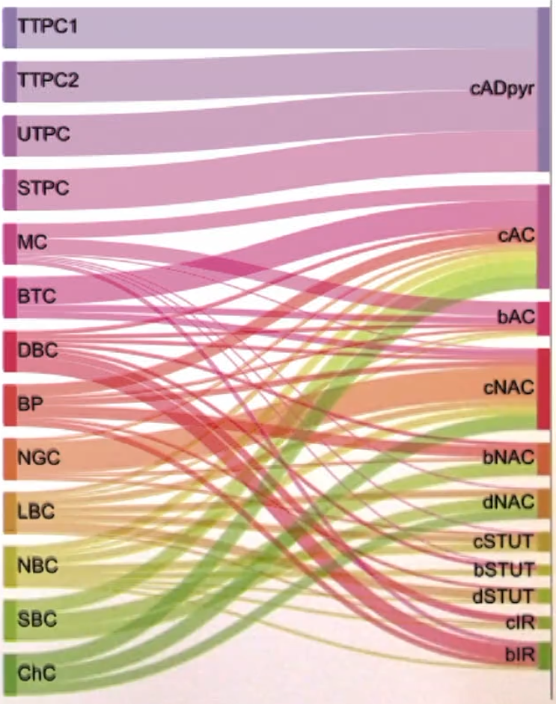
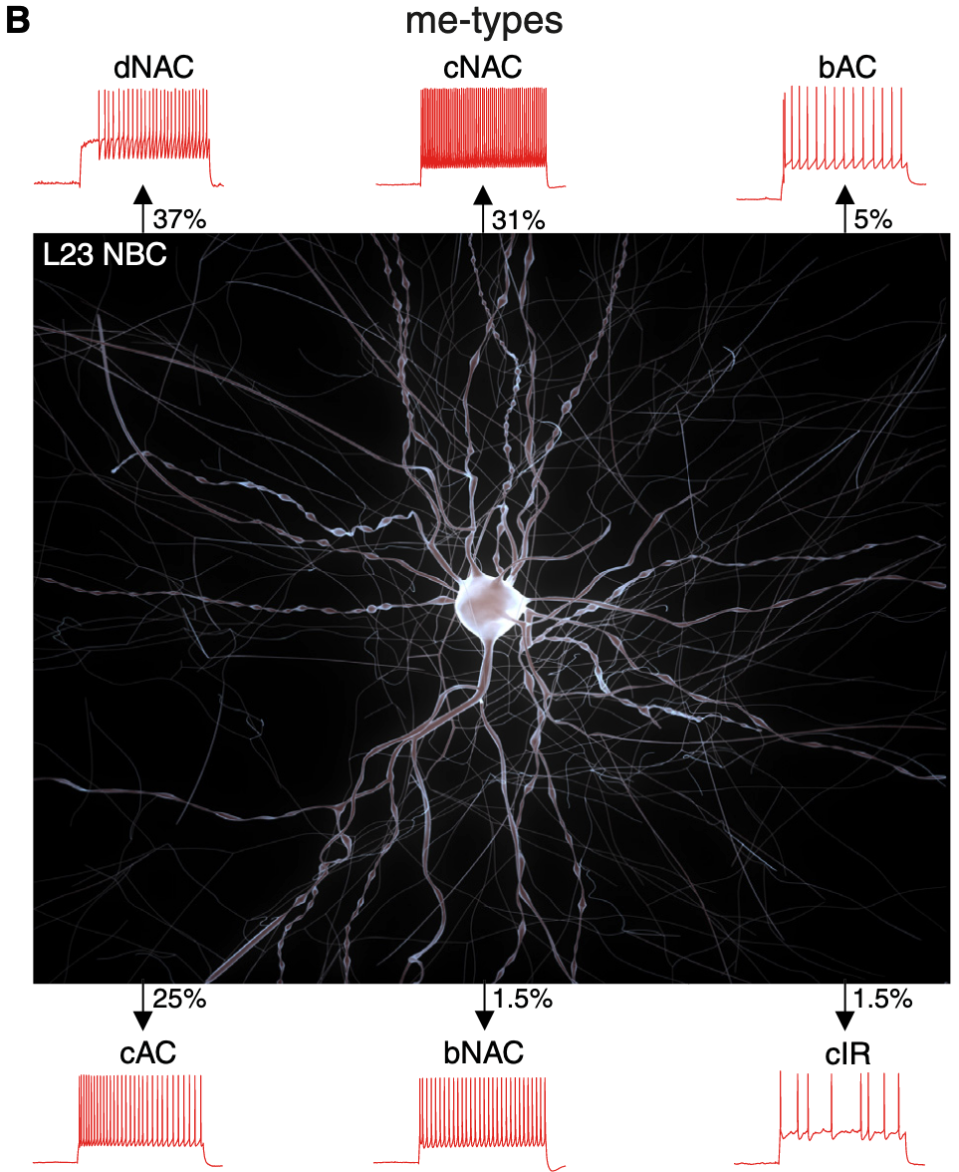
Morpho-electrical types (ME)
m-types
e-types
41

Slide 42
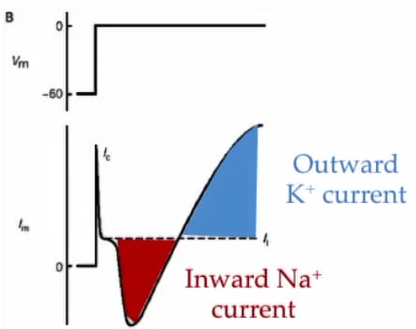
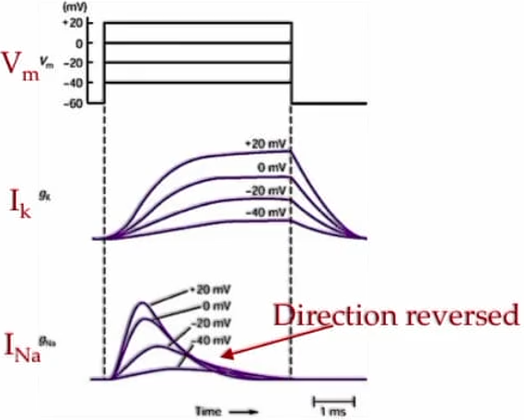
Hodgkin and Huxley experiments
Voltage clamp (fix voltage) of the membrane of a giant squid axon
When moving from -60 mV to 0 mV, they identified a Na⁺ inward current, and a late K⁺ outward current
Voltage clamp to different voltage levels
Later generation of mathematical equations to model these current variations
These currents are both voltage and time dependent
V_{m}
V_{m}
g_{K}
I_{m}
g_{Na}
Time
1 ms
42

Slide 43
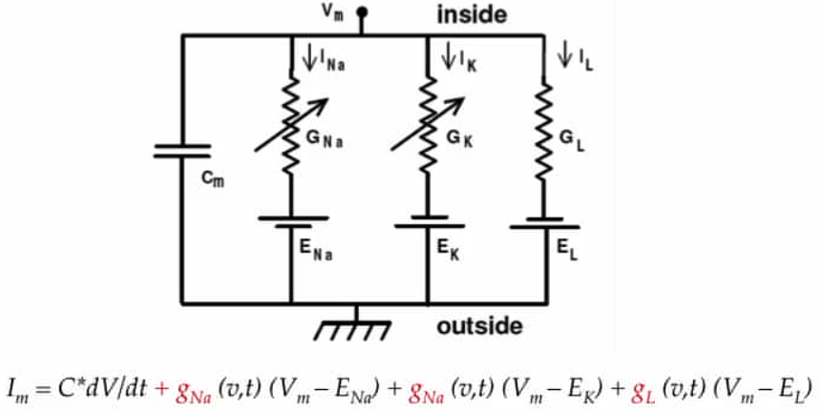
Hodgkin and Huxley model
Representation of the neuronal membrane as an electronic circuit
Conductance is voltage and time dependent (v, t) except for G_{L}
Current of Na / K / leaking channels
Conductance of Na / K / leaking channels
V
Membrane
capacitance
Voltage sources of Na / K / leaking channels
Current flowing
through
the membrane
Capacitance
current (I_{c})
I_{Na}
I_{K}
I_{L}
43

Slide 44
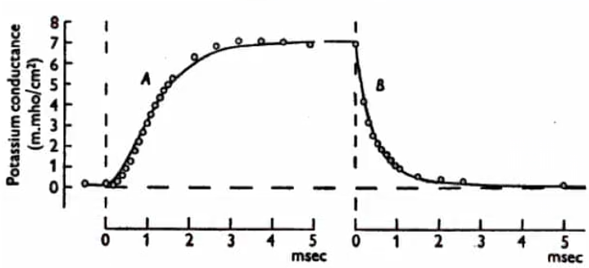
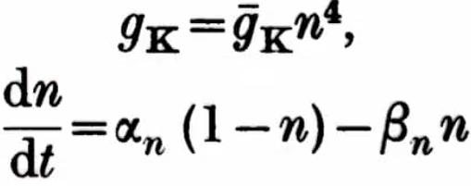
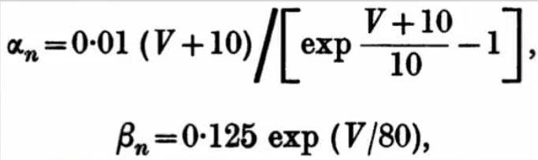
Hodgkin and Huxley model
Equations to fit K⁺ conductance during voltage clamp
n: proportion/probability of K⁺ channels in the open state (0-1). It depends on both voltage and time.
⍺_{n}: Rate constant by which the channels close (voltage dependent)
β_{n}: Rate constant by which the channels open (voltage dependent)
Closed state
Open state
Closed rate constant
Open rate constant

Slide 45
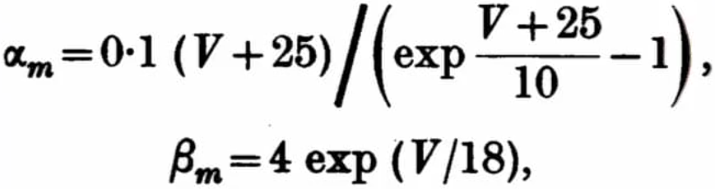
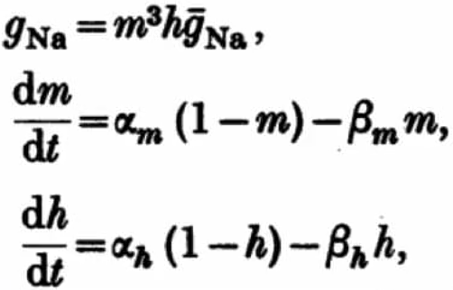
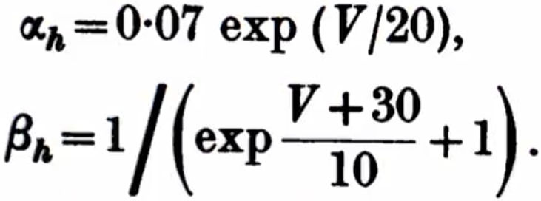
Hodgkin and Huxley model
Equations to fit Na⁺ conductance during voltage clamp
m: proportion/probability of Na⁺ channels in the activated state (0-1). It depends on both voltage and time.
h: proportion/probability of Na⁺ channels in the inactivated state (0-1). It depends on both voltage and time.
⍺ and β represent the open and close rate constants
Activation
Inactivation

Slide 46
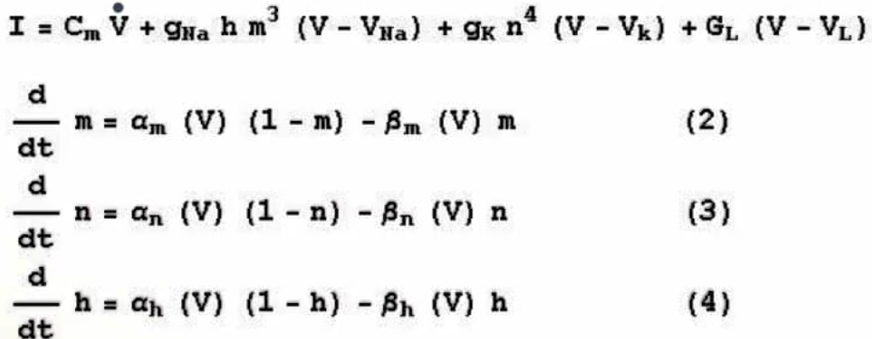
Hodgkin and Huxley model
Complete set of equations of the Hodgkin and Huxley model
Solving these equations gives the value of the voltage over time
This model predicted the refractory period, during which we cannot generate another AP
These equations can represent the behavior of any neuron type of the brain:
We should adjust ⍺ and β constants
Adapt to the ions intervening (e.g., calcium)

Slide 47
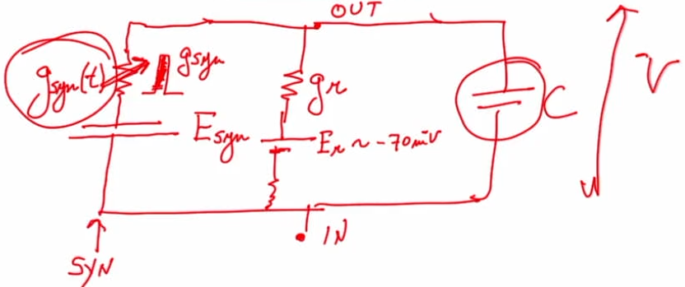
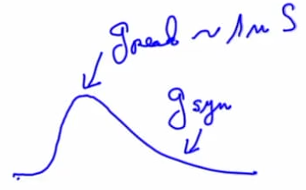
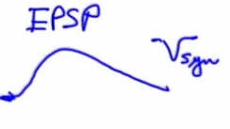





Modeling the postsynaptic potential
Equivalent circuit
Equation of the postsynaptic potential based on conductance
$Im = gsyn \left(V – Esyn\right)+ gK \left(V − Er\right)+C \frac{dV}{dt}$
$Vsyn = \frac{gsyn Esyn +gr Er}{gsyn+gr} \left(1 −e^{−\frac{\left(gsyn+gr\right)t}{C}}\right)$
$gsyn(t) = gpeak N (e^{−\frac{t}{τ1}}{ e}^{−\frac{t}{τ2}})$
I_{m} : current of the membrane
I_{syn} : synaptic current
I_{r} : resting/passive leak current
g_{syn} : conductance of the ion channels sensitive to the transmitter
Dependent on time and the transmitter
g_{r} : conductance of passive leaking channels
V_{syn} : synaptic voltage
g_{peak} : conductance peak (max value)
N : normalization value
I_{syn}
I_{r}
Capacitance
Steady state if there
is no capacitance
Part dependent
on capacitance
Rise
of $gsyn$
Decay
of $gsyn$

Slide 48
Rall’s cable model
VOY POR AQUI DE LA PARTE DE IDAN SEGEV
Después de esto, pasar al 4.2 (modeling synaptic…) para la parte de Srikanth

Slide 49

Hippocampus
Lección del curso 5 (hipocampo): 4.2.1
Tenerla en cuenta para más Adelante cuando avance ya que aquí da diferentes ecuaciones de modelos según resolución

Slide 50
Thank you!
Questions and Discussion
Speaker: Sergio López Bernal

